Slide 1
What's going on under the hood of the ML/AI/Big Data revolution?
Andrew W. Rose
Image credit to Sophia Shao @ UC Berkley & Vivienne Sze @ MIT

Slide 2
It's all about data-structure
It's all about data-structure
It's all about data-structure
It's all about data-structure
It's all about data-structure
It's all about data-structure
It's all about data-structure
It's all about data-structure

Slide 3
It's all about data-structure
“I will, in fact, claim that the difference between a bad programmer and a good one is whether he considers his code or his data structures more important.
Bad programmers worry about the code.
Good programmers worry about data structures and their relationships.”
Linus Torvalds, 2006

Slide 4
It's all about data-structure
It's all about data-structure
It's all about data-structure
It's all about data-structure
If you want to be fast
It's all about data-structure
Best-case scenario

Slide 5
It's all about data-structure
It's all about data-structure
It's all about data-structure
It's all about data-structure
If you want to be fast
It's all about data-structure
If you want to be energy efficient
It's all about data-structure
Best-case scenario
50×
Energy to transfer 64 bits (pJ)

Slide 6
It's all about data-structure: Even more important in parallel systems
“The parallel approach to computing does require that some original thinking be done about numerical analysis and data management in order to secure efficient use.
In an environment which has represented the absence of the need to think as the highest virtue, this is a decided disadvantage”
Daniel Slotnick, 1967

Slide 7
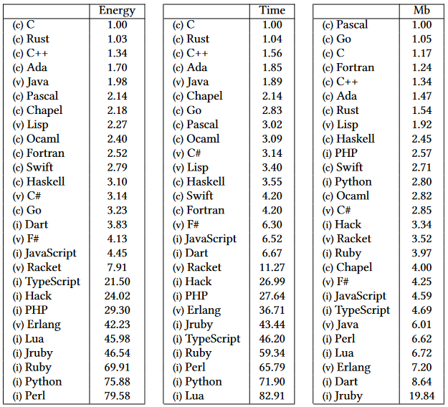
An aside on speed and energy consumption
Pick the right tool for the job
https://greenlab.di.uminho.pt/wp-content/ uploads/2017/10/sleFinal.pdf

Slide 8
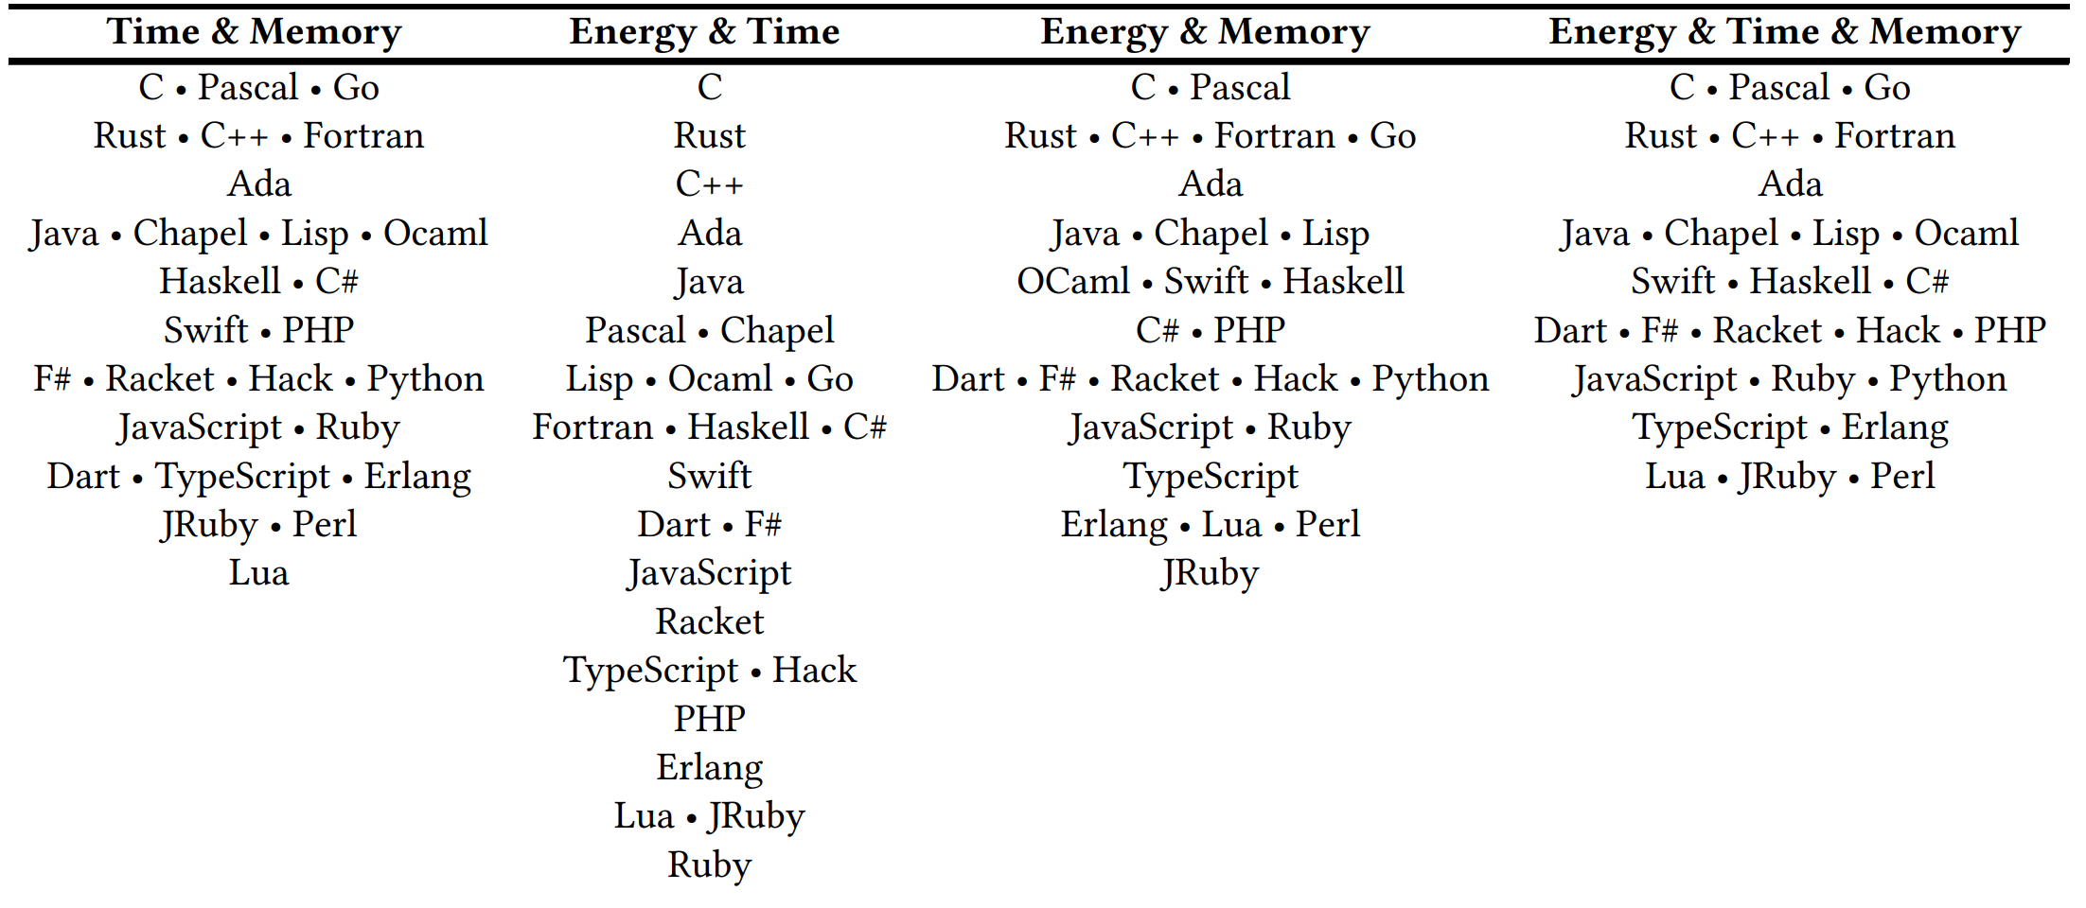
An aside on speed and energy consumption
Pick the right tool for the job
A real-life example of using Pareto fronts
Best
Worst
https://greenlab.di.uminho.pt/wp-content/ uploads/2017/10/sleFinal.pdf
Python doesn't even make the list

Slide 9
History
Solving linear maths is a problem as old as computing itself
Old computers were severely resource-limited and optimising the out of the algorithms was the only option
In the 1990's and 2000's, computers ran fast enough that no-one really cared

Slide 10
History
Solving linear maths is a problem as old as computing itself
Old computers were severely resource-limited and optimising the out of the algorithms was the only option
In the 1990's and 2000's, computers ran fast enough that no-one really cared
But these old tricks are the cornerstone of the AI/ML/Big Data revolution
FORTRAN BLAS library (Basic Linear Algebra Subprograms) implemented GEMM – GEneral Matrix-Matrix Multiplier
… and implemented in all high-performance languages since:
cBLAS, cuBLAS…

Slide 11
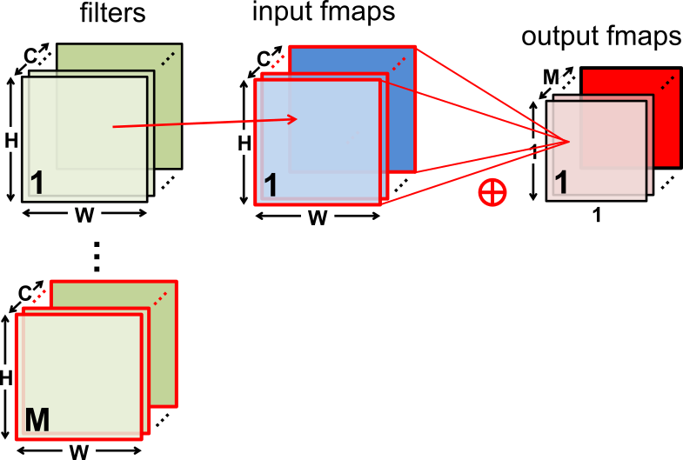
Fully-Connected (FC) Layer
Filters
Input map
Output map

Slide 12
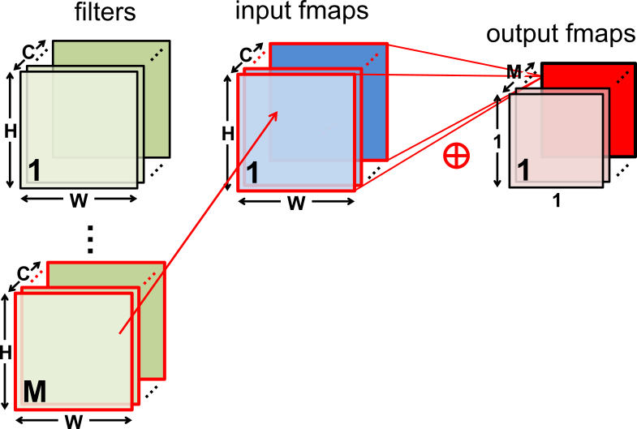
Fully-Connected (FC) Layer
Filters
Input map
Output map

Slide 13
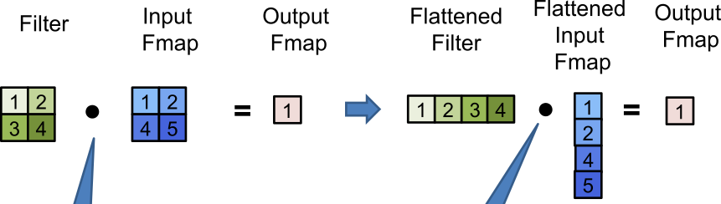
Flattened 2D Dot Product
2D Dot Product
Hadamard Product
Element-wise Product
Entry-wise Product
Schurr Product
1D Dot Product

Slide 14
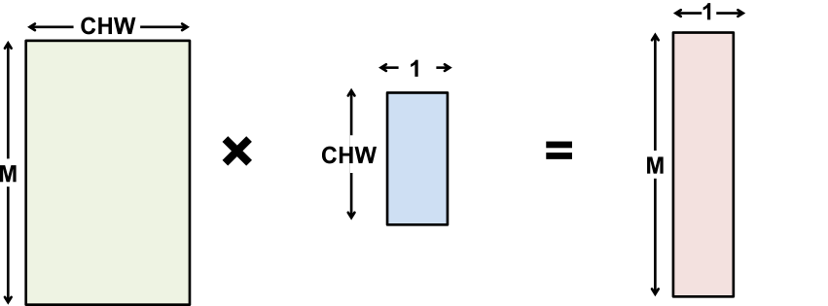
Fully-Connected (FC) Layer
Matrix–Vector Multiply:
Multiply all inputs in all channels by a weight and sum
Filter
Input map
Output map

Slide 15
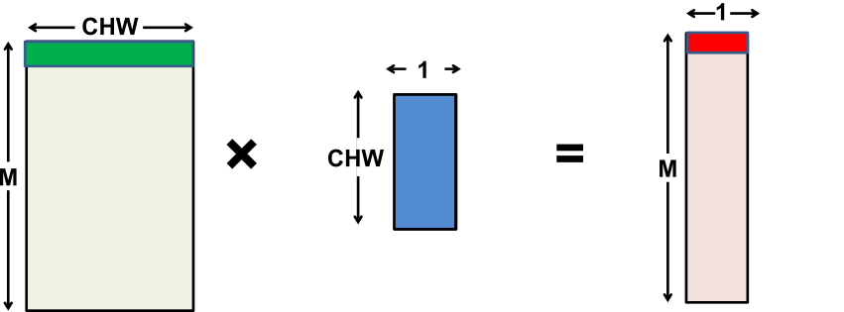
Fully-Connected (FC) Layer
Matrix–Vector Multiply:
Multiply all inputs in all channels by a weight and sum
Filter
Input map
Output map

Slide 16
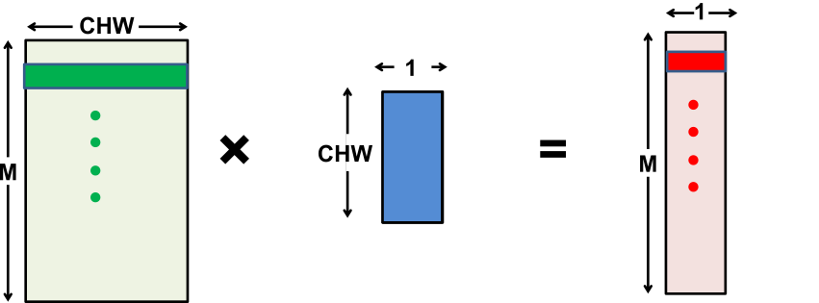
Fully-Connected (FC) Layer
Matrix–Vector Multiply:
Multiply all inputs in all channels by a weight and sum
Filter
Input map
Output map

Slide 17
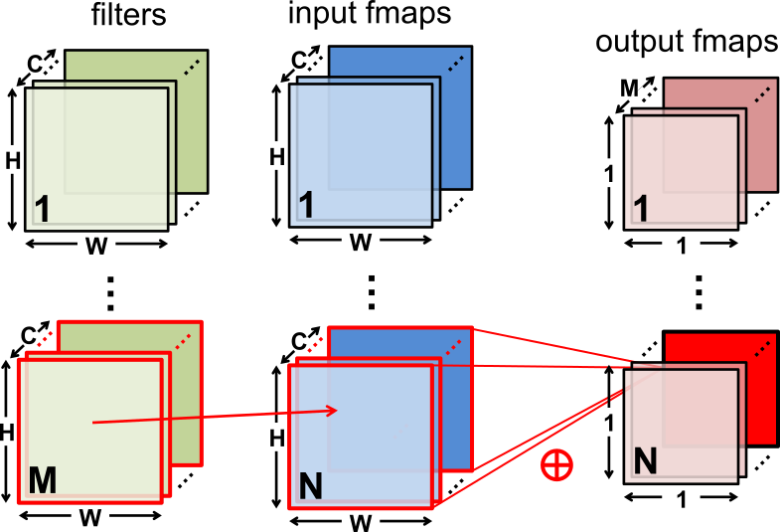
Fully-Connected (FC) Layer
Filters
Input maps
Output maps

Slide 18
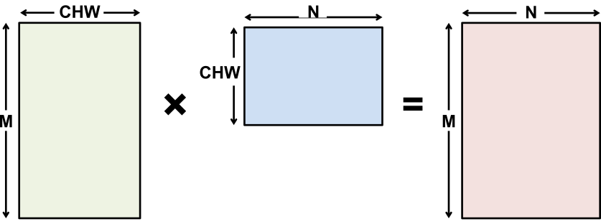
Flattened Fully-Connected Layer
After flattening, having a batch size of N turns the matrix-vector operation into a matrix-matrix multiply
Filter
Input map
Output map

Slide 19
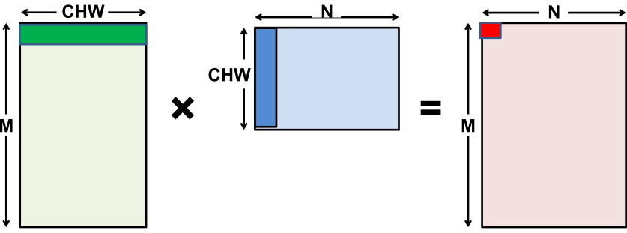
Flattened Fully-Connected Layer
After flattening, having a batch size of N turns the matrix-vector operation into a matrix-matrix multiply
Filter
Input map
Output map

Slide 20
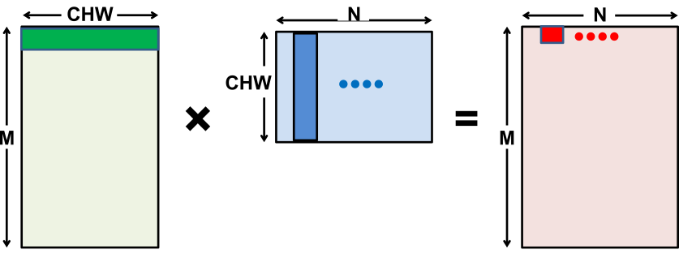
Flattened Fully-Connected Layer
After flattening, having a batch size of N turns the matrix-vector operation into a matrix-matrix multiply
Filter
Input map
Output map

Slide 21
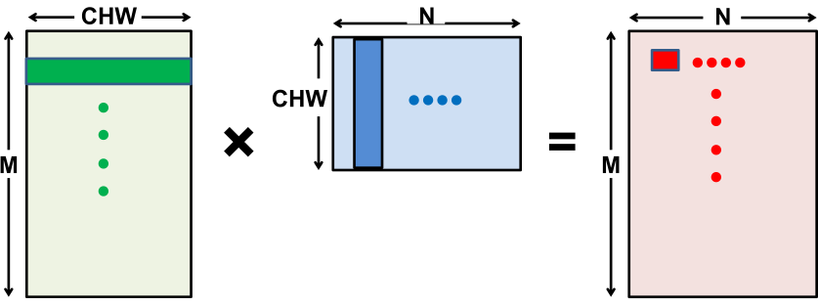
Fully-Connected (FC) Layer
After flattening, having a batch size of N turns the matrix-vector operation into a matrix-matrix multiply
How much temporal locality for naïve implementation? None
Filter
Input map
Output map

Slide 22
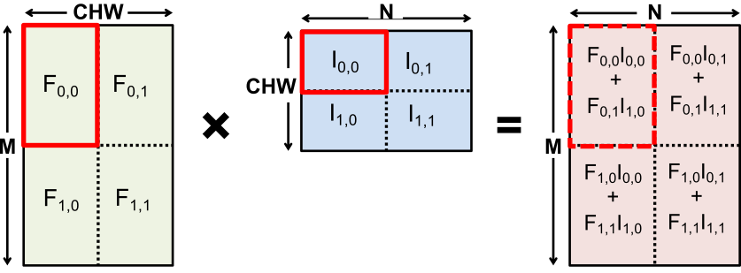
Tiled Fully-Connected (FC) Layer
Matrix multiply tiled to fit in cache and computation ordered to maximize reuse of data in cache
Filter
Input map
Output map

Slide 23
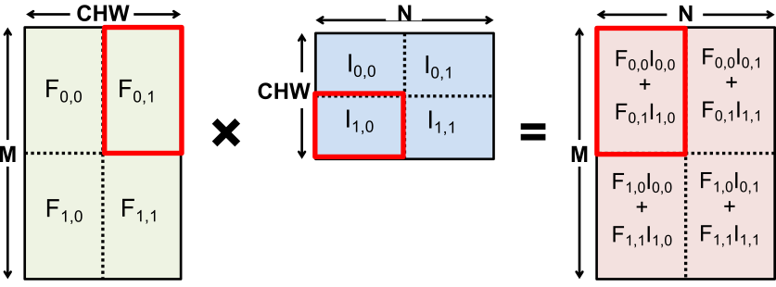
Tiled Fully-Connected (FC) Layer
Matrix multiply tiled to fit in cache and computation ordered to maximize reuse of data in cache
Filter
Input map
Output map

Slide 24
GEMM
It all comes down to optimizing Matrix Multiplication
CPU: OpenBLAS, Intel MKL, etc
GPU: cuBLAS, cuDNN, etc
Library will note shape of the matrix multiply and select implementation optimized for that shape
Optimization usually involves proper tiling to optimize storage hierarchy
Paper here: Anatomy of High-Performance Matrix Multiplication.pdf

Slide 25
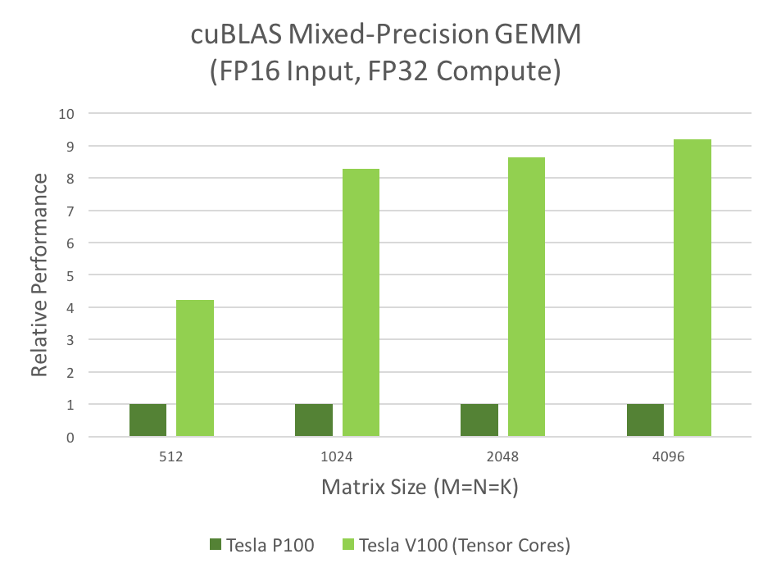
Newer GPUs included dedicated "Tensor Cores"
New opcodes – Matrix Multiply Accumulate (MMA/HMMA/IMMA/DMMA)
FP16 operands: Inputs 48 / Outputs 16
Multiplies: 64
Adds: 64
Tensor Core….
120 TFLOPS @ FP16
400 GFLOPS/W @ FP16

Slide 26
TPU
Top-Level Architecture
Matrix Multiply Unit
Weights
Activations
Partial sums

Slide 27
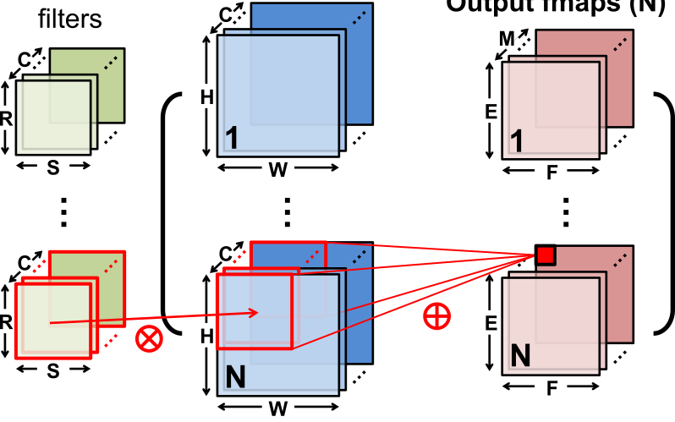
Convolution Layer
Filters
N× Input maps
N× Output maps
Batch Size (N)

Slide 28
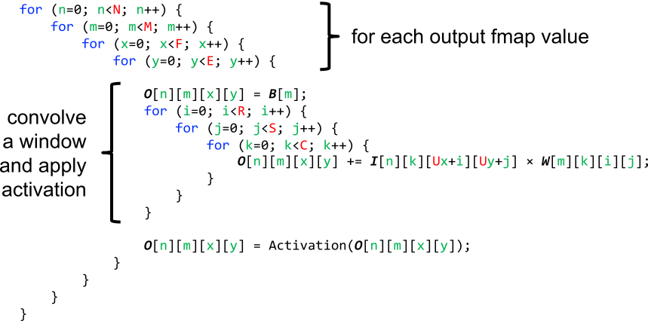
Convolution Layer Implementation
Naïve 7-layer for-loop implementation:
For each output map value
Convolve a window
Apply activation

Slide 29
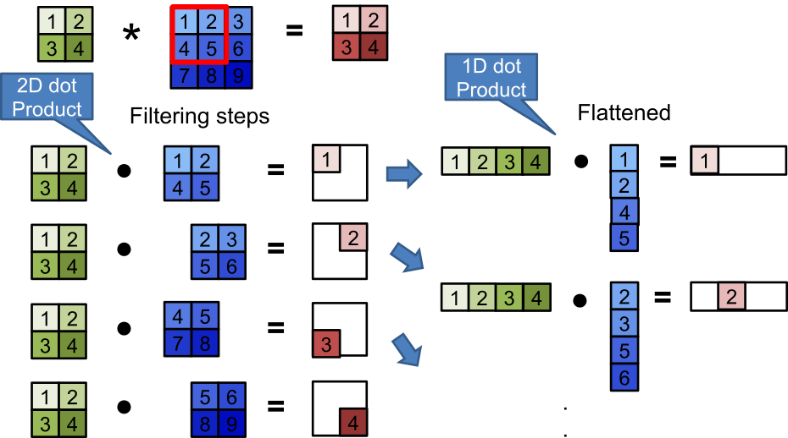
Convolution Layer
Input map
Output map
Filter
2D Dot Product
1D Dot Product

Slide 30
Convolution Layer
Input map
Output map
Filter
Convolution
Flattened

Slide 31
Convolution Layer
Convert to matrix multiply using the Toeplitz Matrix
Input map
Output map
Filter
Convolution
Toeplitz Matrix

Slide 32
Convolution Layer
Convert to matrix multiply using the Toeplitz Matrix – Data is repeated
Input map
Output map
Filter
Convolution
Toeplitz Matrix

Slide 33
Convolution Layer
Considering a higher-dimensional convolution – here over 2 channels
Filter
Input map
Output map
Filter 1
Channel 1
Channel 1
Channel 2
Channel 1
Channel 2

Slide 34
Convolution Layer
Considering a higher-dimensional convolution – here over 2 channels
Toeplitz still applies
Filter
Input map as Toeplitz matrix
Output map
Filter 1
Channel 1
Channel 1
Channel 2
Channel 1
Channel 2

Slide 35
Convolution Layer
Considering multiple higher-dimensional convolution – here 2 × 2 channels
Filter
Input map
Output map
Filter 1
Channel 1
Filter 2
Channel 2
Channel 1
Channel 2
Channel 1
Channel 2

Slide 36
Convolution Layer
Considering multiple higher-dimensional convolution – here 2 × 2 channels
Toeplitz still applies
Filter
Input map as Toeplitz matrix
Output map
Filter 1
Channel 1
Filter 2
Channel 2
Channel 1
Channel 2
Channel 1
Channel 2

Slide 37
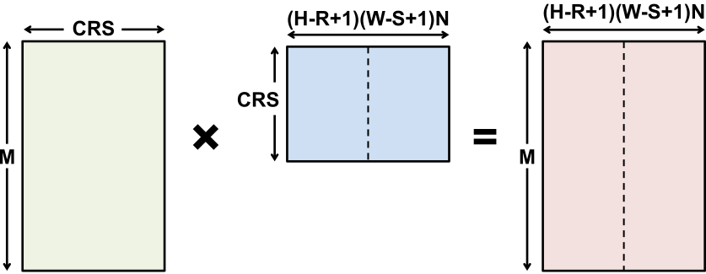
Generally
For any batch size N, any level of parallelism, any number of input or output channels, we can similarly extend matrices
And GEMM will work it's magic
Filter
Input map
Output map

Slide 38
Computational Transforms

Slide 39
Computation Transformations
Goal: Bitwise same result, but reduce number of operations
Focuses mostly on compute

Slide 40
Gauss’s Multiplication Algorithm
1805
Naïve implementation: 4 multiplications + 3 additions
Optimised: 3 multiplications + 5 additions

Slide 41
Karatsuba's Algorithm
1960
Apply Gauss' trick for imaginary numbers to multiplying large integers
Recursively split large numbers into numbers half the size using adds, shifts and smaller multiplications
Reduces complexity from O(N²) to O(N^{1.58})

Slide 42
Strassen
1969
Naïve implementation: 8 multiplications + 4 additions
Optimised: 7 multiplications + 18 additions
7 multiplications + 13 additions (for constant B matrix – weights)

Slide 43
Strassen
1969
Reduce the complexity of matrix multiplication from O(N³) to O(N^{2.807}) by reducing multiplications
Comes at the price of reduced numerical stability and requires significantly more memory
Complexity
Size, N

Slide 44
Winograd 1D – F(2,3)
1980
Targeting convolutions instead of matrix multiply
Notation: F(size of output, filter size)
Naïve implementation: 6 multiplications + 4 additions

Slide 45
Winograd 1D – F(2,3)
1980
Targeting convolutions instead of matrix multiply
Notation: F(size of output, filter size)
4 multiplications + 12 additions + 2 shifts
4 multiplications + 8 additions (for constant weights)

Slide 46
Winograd 2D - F(2x2, 3x3)
1980
1D Winograd is nested to make 2D Winograd
Naïve implementation: 36 multiplications
Winograd: 16 multiplications ≈ 2.25 times reduction
Filter
Input map
Output map

Slide 47
Optimal convolution algorithm depends on convolution layer dimensions
GoogLeNet – batch size 1
Source: Nvidia

Slide 48
Winograd Summary
Winograd is an optimized computation for convolutions
It can significantly reduce multiplies
For example, for 3x3 filter by 2.25X
But, each filter size and output size is a different computation
Paper here: Fast Algorithms for Convolutional Neural Networks.pdf

Slide 49
Winograd as a Transform
Transformed filter GgG^{T} can be precomputed
Transform Input
Element-wise
Filter
Input map

Slide 50
And if we are going to talk about transforms…
The most famous transformation of the 20th and 21st centuries
The Fast Fourier Transform/Discrete Fourier Transform

Slide 51
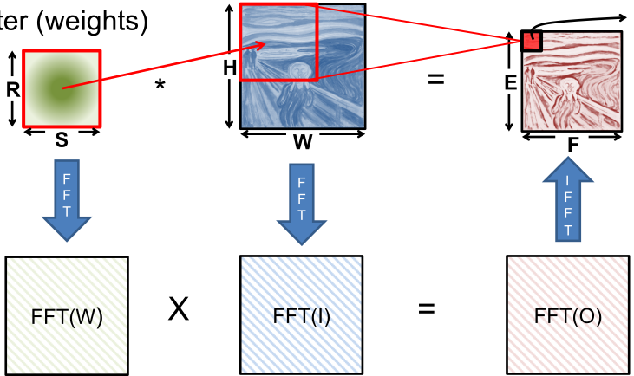
Fast Fourier Transform (FFT)
Filter
Input map
Output map

Slide 52
FFT Overview
Convert filter and input to frequency domain to make convolution a simple multiply then convert back to space domain.
Convert direct convolution O(N_{o}²N_{f}²) computation to O(N_{o}²log₂N_{o})
The computational benefit of FFT increases with increasing size of filter
Or decreases with decreasing size of filter

Slide 53
But nothing comes for free…
Input and Filter matrices are ‘0-completed’
i.e. expanded to size (E+R-1) × (F+S-1)
Frequency domain matrices are same dimensions as input, but complex
FFT often reduces computation, but requires much more memory space and bandwidth

Slide 54
Optimization opportunities
FFT of real matrix is symmetric allowing one to save ½ the computes
Filters can be pre-computed and stored, but convolutional filter in frequency domain is much larger than in space domain
Can reuse frequency domain version of input for creating different output channels to avoid FFT re-computations
Can accumulate across channels before performing inverse transform to reduce number of IFFT

Slide 55
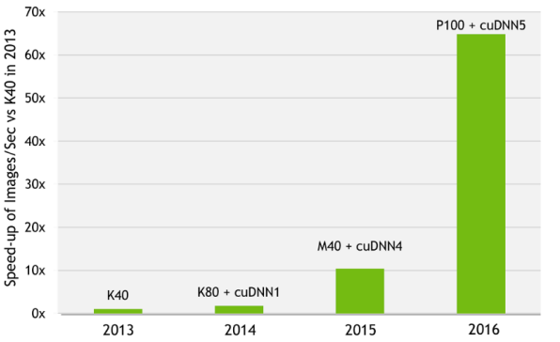
cuDNN: Speed up with Formalised Transforms
And recall, V100 is 4-9× faster than P100 for Matrix maths because of its Tensor core
AlexNet training throughput
Source: Nvidia
60× speed-up in 3 years

Slide 56
It's all about data-structure: Even more important in parallel systems
Didn't have time to go into it today but I'll assert it again…
“The parallel approach to computing does require that some original thinking be done about numerical analysis and data management in order to secure efficient use.
In an environment which has represented the absence of the need to think as the highest virtue, this is a decided disadvantage”
Daniel Slotnick, 1967

Slide 57
Conclusion
The last 75 years have seen many developments in optimisation of linear maths
And it (mostly) comes down to data-structure
More recently the idea of formalized transforms have optimised the parallelization of linear maths on GPUs
And the same tricks apply equally to other parallelised hardware
But even more important
The introduction of dedicated tensor cores hasn't hurt

